Slide 1

Deep Learning with Python
Chapter
6.1-6.2
Book Reading Group
Åke Edlund, Daniel Edsgärd

Slide 2
Session outline – 60 min
Quick summary of the week’s reading, 1-2 slides (5-10 min)
Group discussions (25 min)
See Groups (with place for changes) in Wiki
Discussing this week’s reading
Addressing N number of questions (assigned to the group)
Write your answers directly into the MS Teams Forms + update this ppt (see last slides)
Group presentations of answer slides (~5min/group)
Open discussion, all to particicpate
Summary, wrap up, next session (5 min)
Note: after session, we will update the wiki and files with above input.

Slide 3
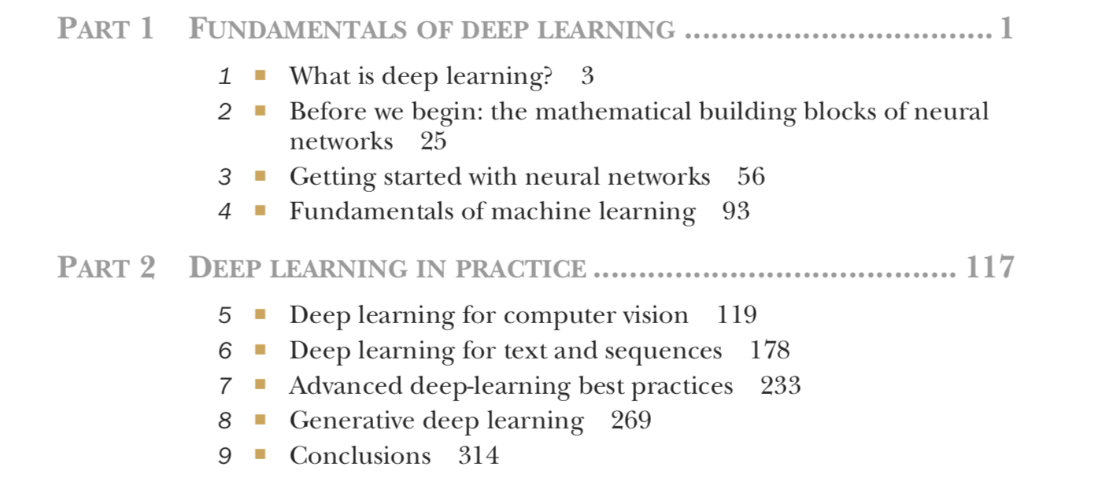
Timeplan
Sep 13 - Chapter 1-2
Sep 20 - Chapter 3
Sep 27 - Chapter 4
Oct 4 - Chapter 5.1-5.2
Oct 11 - Chapter 5.3-5.5
Oct 18 - Chapter 6.1-6.2
Oct 25 - Chapter 6.3-6.5
Nov 1 - Chapter 7
Nov 8 - Chapter 8.1-8.3
Nov 15 - Chapter 8.4-8.6
Nov 22 - Chapter 9

Slide 4
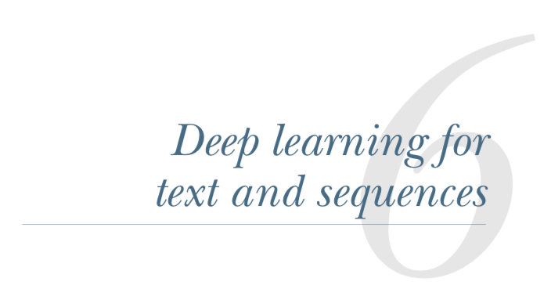
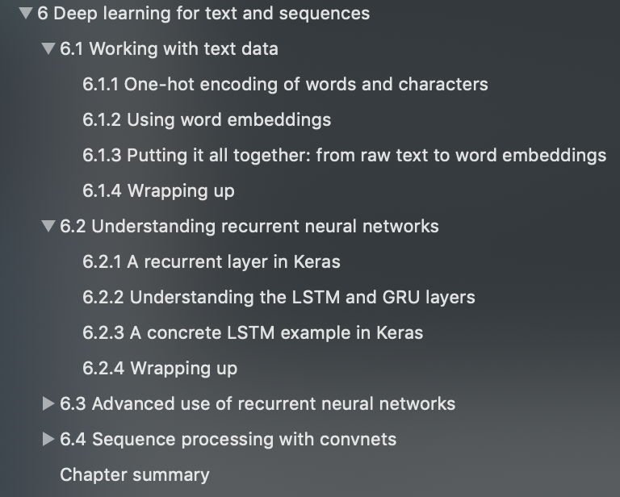
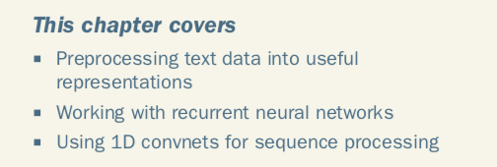
6.1-6.2

Slide 5
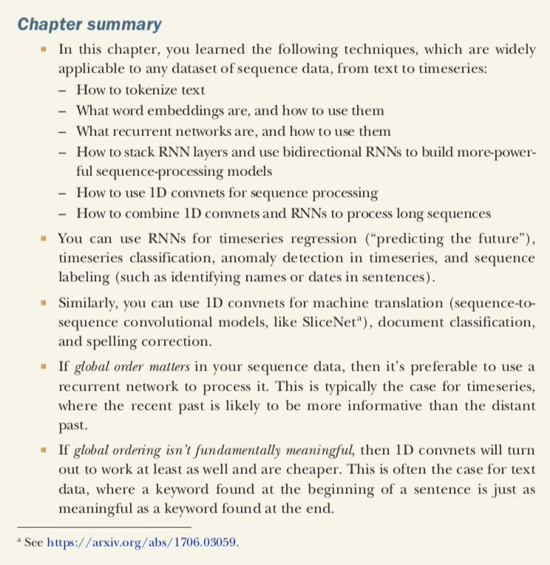
6.1-6.2

Slide 6
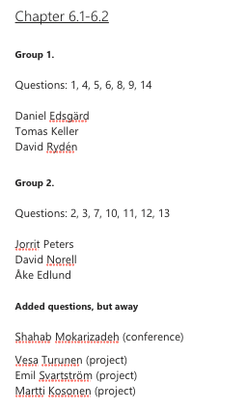
6.1-6.2

Slide 7
Group 1, Questions: 1, 4, 5, 6, 8, 9, 14
1. in chapter 6.2, the book talks about RNN, but later it shows that RNN based model is not outperforming the model used Embedding in 6.1 for sentiment analysis. So what are the specific use cases in NLP context that RNN can outperform Embedding based model? does it make sense tp combine both in one model (having both Embedding layer and RNN)? (Shahab)
See page 206. "But this result isn’t groundbreaking for such a computationally intensive approach. Why isn’t LSTM performing better? One reason is that you made no effort to tune hyperparameters such as the embeddings dimensionality or the LSTM output dimensionality. Another may be lack of regularization. But honestly, the primary rea- son is that analyzing the global, long-term structure of the reviews (what LSTM is good at) isn’t helpful for a sentiment-analysis problem. Such a basic problem is well solved by looking at what words occur in each review, and at what frequency. That’s what the first fully connected approach looked at. But there are far more difficult natural- language-processing problems out there, where the strength of LSTM will become apparent: in particular, question-answering and machine translation."
4. It is stated in the book that the One-hot encoding is one of the most common. To me it is not the most intuitive encoding I can think of since it gives very sparse vectors. Is there any reason why this is so popular?
To us it isn't intuititive what a more intuitive encoding would look like =)

Slide 8
Group 1, Questions: 1, 4, 5, 6, 8, 9, 14
5. Does anybody know if there are useful and well tested word vectors/embeddings for Nordic an dBaltic languages? I.e. what could we use in our work in Telia? (Martti Kosonen)
Fasttext (FB) – used in a text classification POC in January, both for Finnish and Swedish (has for over 200 languages, including all languages within Telia).
6. I understand that the whole 6.1.3. chapter is written from the perspective of 'small training set will not give a high accurace, whatever the method', but how good results with ready made embeddings can be reached in best cases for understanding a text? (Martti Kosonen)
If the embeddings are created using a large corpus, and your text is well covered by that corpus, you should be able to get good performance - even if you have small data sets. If above is not the case, you can further train the network to add your specific words to the embeddings.

Slide 9
Group 1, Questions: 1, 4, 5, 6, 8, 9, 14
8. When doing image classification we could utilize pretrained models where we retrained a few of the pretrained layers. The reasoning for this was to make these general models more focused towards the task at hand. Is there any similar analogy in regards to text analysis? Choullet claims that pre-trained word embeddings are likely to be outperformed by task-specific embeddings with suffiently large data sets. But is there any way to combine the two in a similar fashion as in image classification?
Yes, it's possible.
9. Are there any pretrained word embeddings for the Swedish language? Have we used this at Telia or does someone at Telia have a trained word embedding for the Swedish language which we can reuse? (Jorrit)
(see fasttext, question 5)

Slide 10
Group 1, Questions: 1, 4, 5, 6, 8, 9, 14
14. Is the sequence truncation really necessary for the LSTM in the specific context of the IMDB reviews example in the book? Why are we not padding all sequences to the length of the review with max length? (David Norell)
Would be slower. Highly depending on the review with max length. Need to test – compuational and predictive performance when doing padding.

Slide 11
Group 2, Questions: 2, 3, 7, 10, 11, 12, 13
2. Is character one-hot encoding used somewhere, seems that all context and a lot of information goes missing when implemented? Compared to word level one-hot encoding. (Tomas Keller)
(need to be investigated...)
3. The book says "it's resonable to learn a new embedding space with every new task". It also says that we can use vectors from a pre computed embedding space. Will you try out many different pre computed spaces or how will you work with the pre computed ones? What is the metric for a good set of vectors from a pre computed embedding space? (Tomas Keller)
(need to be investigated...)

Slide 12
Group 2, Questions: 2, 3, 7, 10, 11, 12, 13
7. Training LSTMs require a lot of computations. If you have a lot of data what tricks can you be using in order to process it on a CPU on a local computer? (Tomas Keller)
(there are libraries that can help, e.g. specific numpy installations – not just the vanilla numpy. Also making maximum use of e.g. BLAS libraries and how you order your computations. Look at different types of RNN, e.g. GRU, …)
10. How do you handle the case with long sequences of varying length? In the book they handle the reviews by using the same seq-len for all reviews (max_len=500 on p200) and padding if shorter than max_len. If we want to use all information, would it be a good strategy to set max_len to the length of the longest review? An alternative could be to split the timeseries into individual sequences, should one then keep the state between such sequences originating from the same series? (Daniel Edsgärd)

Slide 13
Group 2, Questions: 2, 3, 7, 10, 11, 12, 13
11. If you split a long timeseries into individual sequences (see Q10 above), would one use a sliding window, consecutive windows or sampled windows? (Daniel Edsgärd)
(… will clarify this)
12. If one has a single timeseries (input_features=1) and correlation between t and t-2 and you model it with a simpleRNN layer, would it suffice with a single output feature? (Daniel Edsgärd)

Slide 14
Group 2, Questions: 2, 3, 7, 10, 11, 12, 13
13. In the IMDB review sentiment classification they remove infrequent words. Is that always advisable or is it common that many rare words could in aggregate have an effect (subgroups of documents belonging to the same class, where each small subgroup has a rare word with strong segregating effect). (Daniel Edsgärd)
(Look at tf-idf)

